Slide 1
AZ-104T00A Administer Monitoring

Slide 2



Administer Monitoring Introduction
Configure Azure Monitor
Configure Azure Alerts
Configure Log Analytics
Lab 11 – Implement Monitoring
Notes:
This content is part of the AZ-104: Monitor and back up Azure resources (https://docs.microsoft.com/learn/paths/az-104-monitor-backup-resources/) learning path.
Module overview – Network Watcher has moved to Traffic Management in networking.

Slide 3
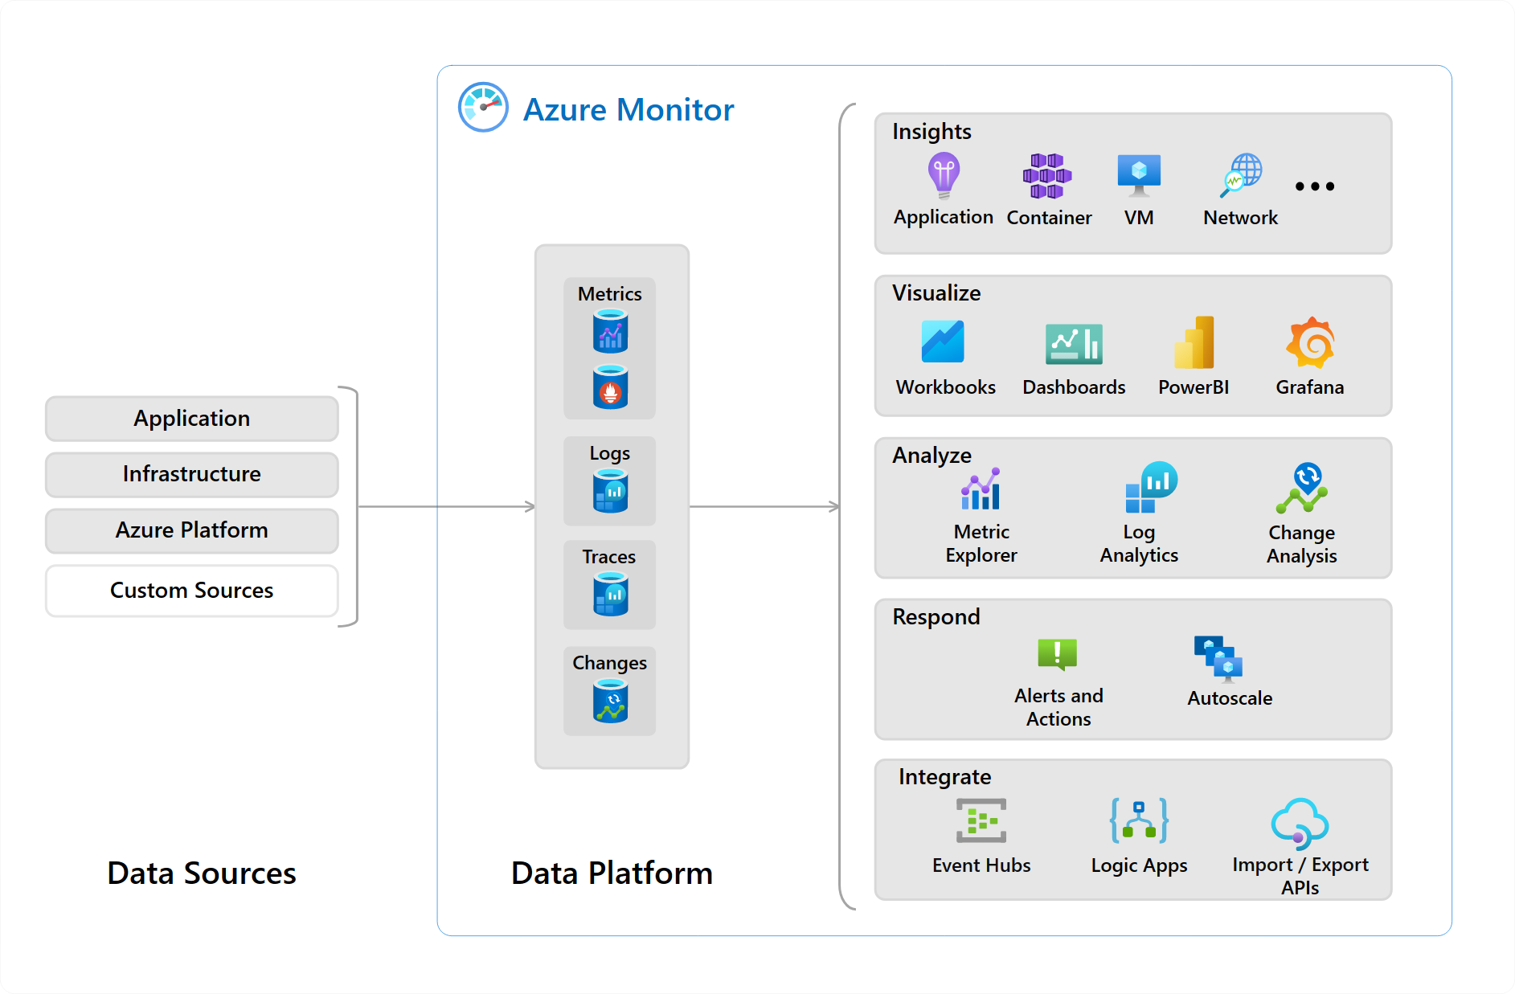
Administer Monitoring whiteboard and review
Name at least three data sources that can be used by Azure Monitor.
How can you notify Help Desk personnel of an issue? What notification methods are available?
You need to search the Windows Event log. What tool can you use? How would you search for errors?
Notes:
Optional whiteboard slide to introduce the module or review the content. Use the whiteboard diagram directly or recreate the image during the class.
Name at least three data sources that can be used by Azure Monitor.
Answer: Azure Monitor can ingest many different data sources. Sources include application code, operating system, resource, subscription, and tenant data. You can even create your own custom data source. Data sources generally fall into two categories metrics and logs. Metrics are numerical values that describe some aspect of a system at a point in time. For example, virtual machine CPU performance. Logs contain data organized into records with different sets of properties for each type. For example, the activity log shows subscription-level events. This includes such information as when a resource is modified or when a virtual machine is started.
You need to configure several Azure alerts. How will you assign/notify the help desk personnel when an alert is triggered? What methods can be used to notify them?
Answer: The help desk personnel should be added to an action group. An action group is a collection of notification preferences. Alerts use action groups to notify users that an alert has been triggered. Various alerts may use the same action group or different action groups depending on the user's requirements. Notification methods include push notifications to the Azure mobile app, email, SMS, and voice.
You are reviewing the Azure Monitor alerts page. What alert states (statuses) are possible?
Answer: There are three alert states New, Acknowledged, and Closed. New indicates an issue has been detected and hasn’t been reviewed. Acknowledged indicates an administrator has reviewed the alert and started working on it. Closed indicates the issue has been resolved. You can reopen a closed alert if the issue returns.
You would like to structure queries against the Windows Event log. Specifically, you would like to identify any errors. What product should you use? What query language is available to construct the query?
Answer: You should use a Log Analytics workspace. The workspace can receive data from the Windows Event log. The event records can then be visualized or queried. Azure uses the Kusto query language. Windows Event logs are stored in the Event table. to query the event table for errors, use this command: Event | where (EventLevelName == "Error").

Slide 4
Configure Azure Monitor

Slide 5




Configure Azure Monitor Introduction
Describe Azure Monitor Key Capabilities
Describe Azure Monitor Components
Define Metrics and Logs
Identify Data Types
Describe Activity Log Events
Query the Activity Log
Summary and Resources
Notes:
Monitor and maintain Azure resources (10–15%)
Monitor resources in Azure
Interpret metrics in Azure Monitor
Configure log settings in Azure Monitor
Query and analyze logs in Azure Monitor
Set up alert rules, action groups, and alert processing rules in Azure Monitor
Configure and interpret monitoring of virtual machines, storage accounts, and networks by using Azure Monitor Insights

Slide 6
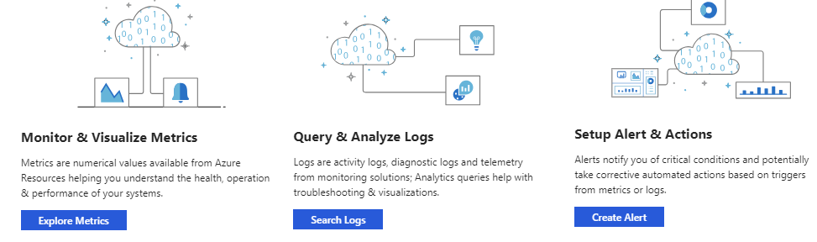
Describe Azure Monitor Key Capabilities
Core monitoring for Azure services
Collects metrics, activity logs, and diagnostic logs
Use for time critical alerts and notifications

Slide 7
Understand Azure Monitor Components
Notes:
What is Azure Monitor - https://docs.microsoft.com/azure/azure-monitor/overview

Slide 8
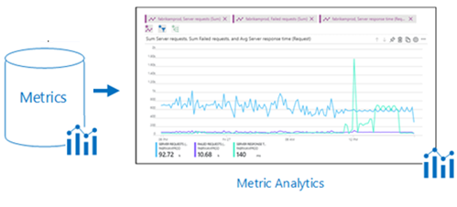
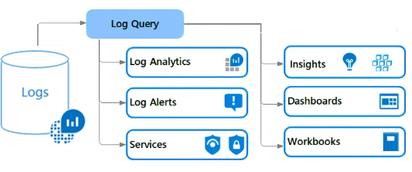
Define Metrics and Logs
Metrics are numerical values that describe some aspect of a system at a point in time
They are lightweight and capable of supporting near real-time scenarios
Logs contain different kinds of data organized into records with different sets of properties for each type
Telemetry (events, traces) and performance data can be combined for analysis
Notes:
For your use there are 3 additional slides at the end of the presentation.
Metrics - https://docs.microsoft.com/azure/azure-monitor/platform/data-platform-metrics
Logs - https://docs.microsoft.com/azure/azure-monitor/platform/data-platform-logs

Slide 9



Identify Data Types
Application monitoring data – Performance and functionality of the code you have written, regardless of its platform
Guest OS monitoring – Azure, another cloud, or on-premises
Azure resource monitoring
Azure subscription monitoring – Operation and management of an Azure subscription, as well as data about the health and operation of Azure itself
Azure tenant monitoring – Operation of tenant-level Azure services, such as Azure Active Directory
Notes:
Sources of monitoring data for Azure Monitor - https://docs.microsoft.com/azure/azure-monitor/platform/data-sources

Slide 10
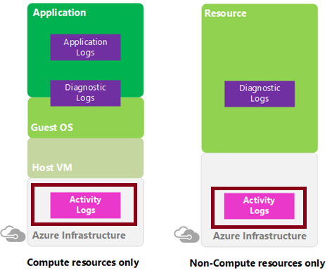
Describe Activity Log Events
Send data to Log Analytics for advanced search and alerts
Query or manage events in the Portal, PowerShell, CLI, and REST API
Stream information to Event Hub
Archive data to a storage account
Analyze data with Power BI
Notes:
Azure Activity log - https://docs.microsoft.com/azure/azure-monitor/platform/activity-log
Send Azure Activity log to Log Analytics workspace using Azure portal - https://docs.microsoft.com/azure/azure-monitor/learn/quick-collect-activity-log-portal

Slide 11
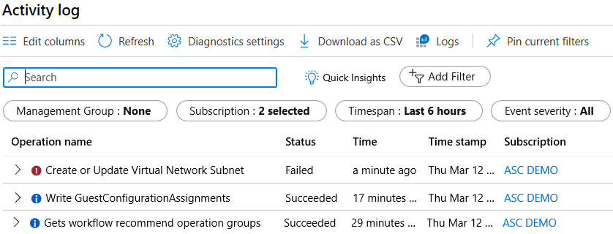
Query the Activity Log
Filter by Management group, Subscription, Timespan, and Event Severity
Add a filter, like Event Category (Security, Recommendations, Alerts)
Pin current filters and download as CSV
Notes:
Query the Activity Log in the Azure portal - https://docs.microsoft.com/azure/monitoring-and-diagnostics/monitoring-overview-activity-logs#query-the-activity-log-in-the-azure-portal

Slide 12
Summary and Resources – Configure Azure Monitor
Knowledge Check Questions
Microsoft Learn Modules (docs.microsoft.com/Learn)
Monitor, diagnose, and troubleshoot your Azure storage (Sandbox)
Analyze your Azure infrastructure by using Azure Monitor logs (Sandbox)
Monitor and report on security events in Azure AD Docs
Monitor the performance of virtual machines using Azure Monitor VM Insights (Sandbox)
A sandbox indicates a hands-on exercise.
Notes:
https://docs.microsoft.com/learn/
The Assessment Guide in the MCT DLC has open-ended questions.
Name at least three data sources that can be used by Azure Monitor.
Answer: Azure Monitor can ingest many different data sources. Sources include application code, operating system, resource, subscription, and tenant data. You can even create your own custom data source. Data sources generally fall into two categories metrics and logs. Metrics are numerical values that describe some aspect of a system at a point in time. For example, virtual machine CPU performance. Logs contain data organized into records with different sets of properties for each type. For example, the activity log shows subscription-level events. This includes such information as when a resource is modified or when a virtual machine is started.

Slide 13
Configure Azure Alerts
Notes:
Monitor and maintain Azure resources (10–15%)
Monitor resources by using Azure Monitor
Set up alerts and actions

Slide 14

Configure Azure Alerts Overview
Manage Azure Monitor Alerts
Create Alert Rules
Create Action Groups
Demonstration – Alerts
Summary and Resources
Notes:
Monitor and maintain Azure resources (10–15%)
Monitor resources in Azure
Interpret metrics in Azure Monitor
Configure log settings in Azure Monitor
Query and analyze logs in Azure Monitor
Set up alert rules, action groups, and alert processing rules in Azure Monitor
Configure and interpret monitoring of virtual machines, storage accounts, and networks by using Azure Monitor Insights

Slide 15
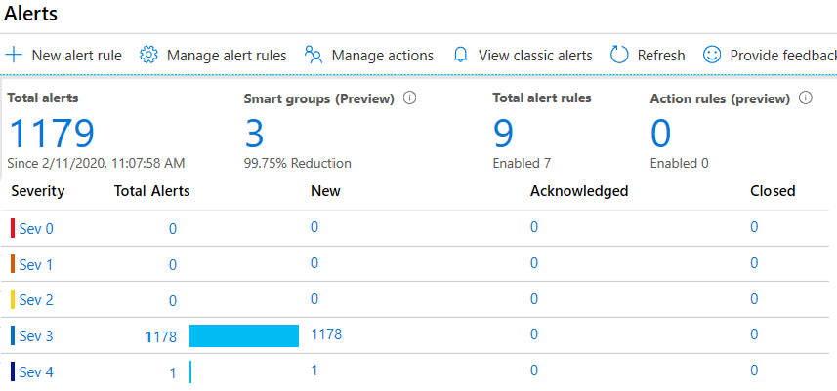
Manage Azure Monitor Alerts
Unified authoring experience
Displayed by severity
Categorized by New, Acknowledged, and Closed
Notes:
The new alerts experience in Azure Monitor - https://docs.microsoft.com/azure/monitoring-and-diagnostics/monitoring-overview-unified-alerts

Slide 16
Create Alert Rules
Scope: Target selection, Alert criteria, and Alert logic
Alert rule details: name, description, and severity (0 to 4)
Action group: Notify your team via email and text messages or automate actions using webhooks and runbooks
Notes:
Respond to events with Azure Monitor Alerts - https://docs.microsoft.com/azure/azure-monitor/learn/tutorial-response
Create, view, and manage metric alerts using Azure Monitor - https://docs.microsoft.com/azure/azure-monitor/platform/alerts-metric

Slide 17
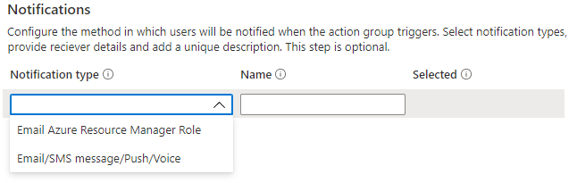
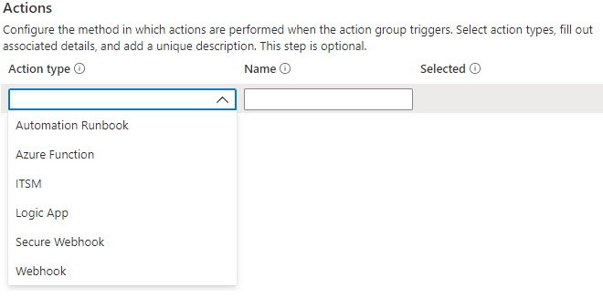
Create Action Groups
Configure the method in which users will be notified when the action group triggers
Configure the method in which actions are performed when the action group triggers
Notes:
Create and manage action groups in the Azure portal - https://docs.microsoft.com/azure/azure-monitor/platform/action-groups

Slide 18
Demonstration – Alerts
Create and configure an alert rule
Review alerts
Notes:
Create, view, and manage Metric Alerts Using Azure Monitor - https://docs.microsoft.com/azure/azure-monitor/alerts/alerts-metric

Slide 19
Summary and Resources – Configure Azure Alerts
Knowledge Check Questions
Microsoft Learn Modules (docs.microsoft.com/Learn)
Improve incident response with alerting on Azure (Sandbox)
Configure for alerts and detections in Microsoft Defender for Endpoint
Manage alerts and incidents in Microsoft Defender for Endpoint
Remediate security alerts using Microsoft Defender for Cloud
A sandbox indicates a hands-on exercise.
Notes:
https://docs.microsoft.com/learn/
The Assessment Guide in the MCT DLC has open-ended questions.
You need to configure several Azure alerts. How will you assign/notify the help desk personnel when an alert is triggered? What methods can be used to notify them?
Answer: The help desk personnel should be added to an action group. An action group is a collection of notification preferences. Alerts use action groups to notify users that an alert has been triggered. Various alerts may use the same action group or different action groups depending on the user's requirements. Notification methods include push notifications to the Azure mobile app, email, SMS, and voice.
You are reviewing the Azure Monitor alerts page. What alert states (statuses) are possible?
Answer: There are three alert states New, Acknowledged, and Closed. New indicates an issue has been detected and hasn’t been reviewed. Acknowledged indicates an administrator has reviewed the alert and started working on it. Closed indicates the issue has been resolved. You can reopen a closed alert if the issue returns.

Slide 20
Configure Log Analytics
Notes:
Monitor and maintain Azure resources (10–15%)
Monitor resources by using Azure Monitor
Configure and interpret metrics
Configure Azure Monitor Logs

Slide 21

Configure Log Analytics Introduction
Determine Log Analytics Uses
Create a Workspace
Query Log Analytics Data
Structure Log Analytics Queries
Demonstration – Log Analytics
Summary and Resources
Notes:
Monitor and maintain Azure resources (10–15%)
Monitor resources in Azure
Interpret metrics in Azure Monitor
Configure log settings in Azure Monitor
Query and analyze logs in Azure Monitor
Set up alert rules, action groups, and alert processing rules in Azure Monitor
Configure and interpret monitoring of virtual machines, storage accounts, and networks by using Azure Monitor Insights

Slide 22
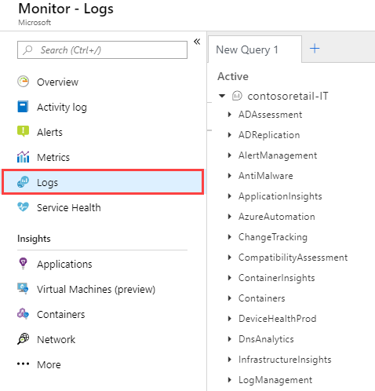
Determine Log Analytics Uses
A service that helps you collect and analyze data generated by resources in your cloud and on-premises environments
Write log queries and interactively analyze their results
Examples include assessing system updates and troubleshooting operational incidents
Notes:
Overview of Azure Monitor agents - https://docs.microsoft.com/azure/azure-monitor/platform/agents-overview

Slide 23
Create a Workspace
A workspace is an Azure resource and is a container where data is collected, aggregated, analyzed, and presented
You can have multiple workspaces per Azure subscription, and you can have access to more than one workspace
A workspace provides a geographic location, data isolation, and scope
Notes:
Create a Log Analytics workspace in the Azure portal -https://docs.microsoft.com/azure/azure-monitor/learn/quick-create-workspace

Slide 24
Query Log Analytics Data
Common queries and a query language (KQL) for custom searches
Quickly retrieve and consolidate data in the repository
Save or have log searches run automatically to create an alert
Export the data to Power BI or Excel
Notes:
Overview of log queries in Azure Monitor - https://docs.microsoft.com/azure/azure-monitor/log-query/log-query-overview
Get started with log queries in Azure Monitor - https://docs.microsoft.com/azure/azure-monitor/log-query/get-started-queries

Slide 25
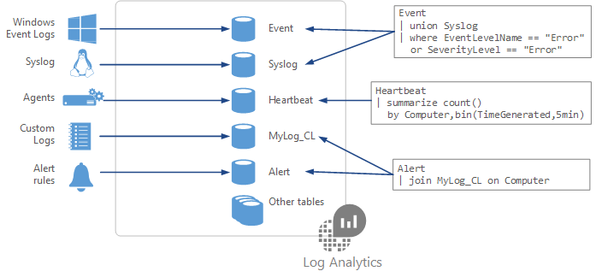
Structure Log Analytics Queries
Event
| where (EventLevelName == "Error")
| where (TimeGenerated > ago(1days))
| summarize ErrorCount = count() by Computer
| top 10 by ErrorCount desc
Notes:
Azure Monitor log queries - https://docs.microsoft.com/azure/azure-monitor/log-query/query-language
Azure Monitor log query examples - https://docs.microsoft.com/azure/azure-monitor/log-query/examples

Slide 26
Demonstration – Log Analytics
Review built-in
log queries
Review the KQL
language
Notes:
Log Analytics tutorial - Azure Monitor - https://docs.microsoft.com/azure/azure-monitor/logs/log-analytics-tutorial

Slide 27
Summary and Resources – Configure Log Analytics
Knowledge Check Questions
Microsoft Learn Modules (docs.microsoft.com/Learn)
Analyze your Azure infrastructure by using Azure Monitor logs (Sandbox)
Monitor the performance of virtual machines using Azure Monitor VM Insights (Sandbox)
Write your first query with Kusto Query Language
A sandbox indicates a hands-on exercise.
Notes:
https://docs.microsoft.com/learn/
The Assessment Guide in the MCT DLC has open-ended questions.
You would like to structure queries against the Windows Event log. Specifically, you would like to identify any errors. What product should you use? What query language is available to construct the query?
Answer: You should use a Log Analytics workspace. The workspace can receive data from the Windows Event log. The event records can then be visualized or queried. Azure uses the Kusto query language. Windows Event logs are stored in the Event table. to query the event table for errors, use this command:
Event
| where (EventLevelName == "Error")

Slide 28
Lab 11 – Implement Monitoring

Slide 29
Lab 11 – Implement monitoring
Lab scenario
You need to evaluate Azure functionality that would provide insight into performance and configuration of Azure resources, focusing on Azure virtual machines. To accomplish this, you intend to examine the capabilities of Azure Monitor, including Log Analytics
Objectives
Task 1: Provision the lab environment
Task 2: Create and configure an Azure Log Analytics workspace and Azure Automation-based solutions
Task 3: Review default monitoring settings of Azure virtual machines
Task 4: Configure Azure virtual machine diagnostic settings
Task 5: Review Azure Monitor functionality
Task 6: Review Azure Log Analytics functionality
Next slide for an architecture diagram
Notes:
LAB 11 - Implement Monitoring - ESTIMATED DURATION 45 MIN
Lab Repository - https://microsoftlearning.github.io/AZ-104-MicrosoftAzureAdministrator/

Slide 30





Lab 11 – Architecture diagram
Task 1
az104-11-rg0
az104-11-vnet 10.0.0.0/24
Task 3
Subnet0 10.0.0.0/26
az104-11-rg0
Task 6
Task 4, Task 5
Task7
Azure Monitor
az104-11-vm0
10.0.0.4
LogAnalyticsWorkspace
New alert rule
Task 2
AutomationAccount
CloudShell
Register the Microsoft.Insights and Microsoft.AlertsManagement resource providers

Slide 31

End of presentation

